Slide 1

SmartStock Inventory Optimization – Weekly Progress Update
Frontend Development Report
Presented by: Siva Teja

Slide 2


Project Overview
Inventory Optimization
Core Features
Robust Tech Stack
Key functionalities include real-time stock monitoring, preventing Stockouts and overstocking products and powerful ML-based sales predictions.
Built on a modern technology stack featuring React.js for the frontend, a Python backend, a scalable database, and integrated machine learning models.
SmartStock is an advanced inventory optimization system specifically designed for retail environments, ensuring efficient stock management.

Slide 3

Work Completed This Week: Frontend Progress
My Contribution:
Developed the Products Page UI, focusing on intuitive layout.
Constructed the Predictions Page UI,
Implemented seamless navigation pathways, ensuring a smooth user journey between core application pages.
Ensured consistent styling across all developed interfaces.

Slide 4
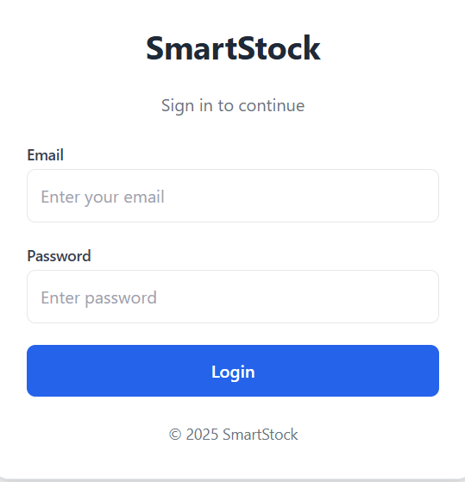
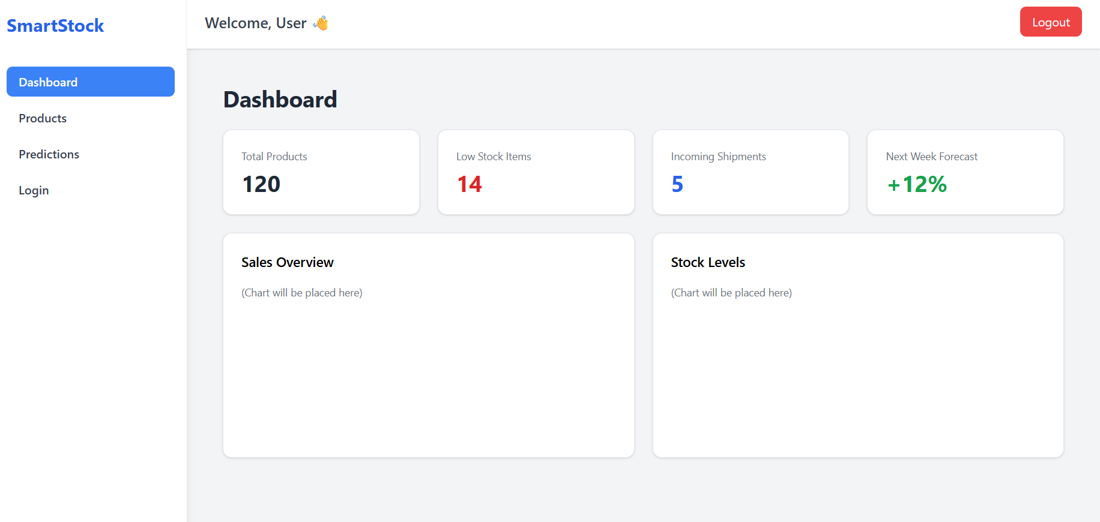
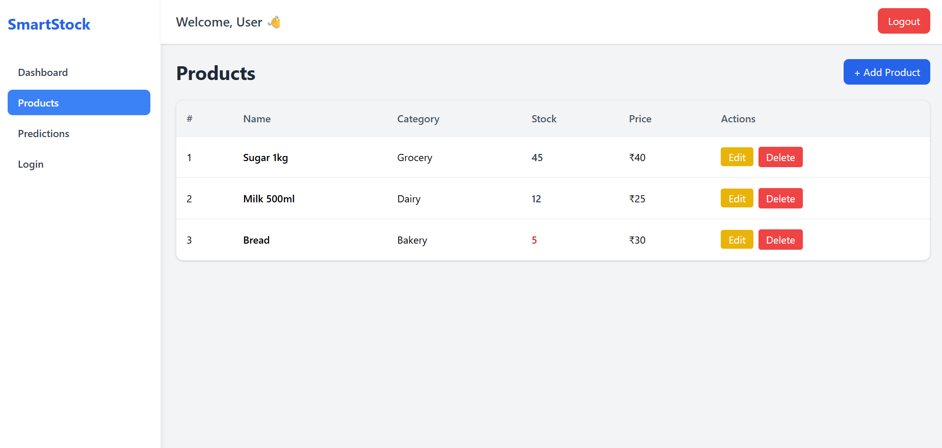
UI Pages Developed: A Visual Tour
We've made significant strides in building out the core user interfaces for SmartStock.

Slide 5





Technical Highlights & Best Practices
Modular Components
Efficient Routing
Utilized reusable React components for each page, promoting maintainability and scalability across the application.
Implemented robust routing with React Router to manage navigation states and user flows seamlessly.
Clean UI Structure
Organized Architecture
Developed a pristine UI foundation, perfectly poised for streamlined backend integration and data population.
Established a clear and logical folder and component architecture, ensuring project clarity and efficient collaboration.

Slide 6
Thank You!
Questions & Discussion
We appreciate your time and attention to our weekly progress. We're excited about the future of SmartStock and welcome any questions or feedback you may have.

